Slide 1
Chapter 1: Introduction

Slide 2
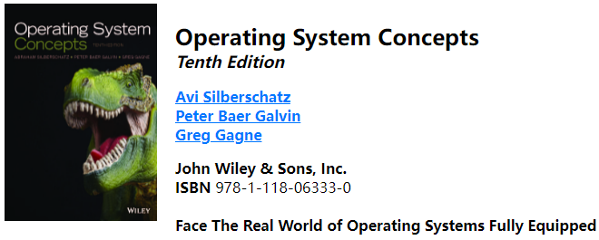
Course References
No mandatory textbook
Lecture slides are your primary reference
Other references to be provided as we proceed
Recommended textbook:
https://codex.cs.yale.edu/avi/os-book/OS10/index.html

Slide 3
Workload
1 midterm exam
2 take-home assignments
1 final exam
6 lab assignments

Slide 4
What to expect
The course would be quite involved
Lot of concepts
Some programming
Reasonable workload
Let me know if you have any question
I guarantee that
I will encourage you to do your best
You’ll have fun
I’ll help you learn as much as I can – don’t hesitate to ask for help whenever needed
Although you won’t become experts, you will learn enough to move on!

Slide 5
What I expect of you
Please do attend each Lecture and each Lab!
Review lecture slides after each lecture!
Ask questions during lectures!
Ask questions over email
hzb564@jnu.edu.cn this one!
Try to start early on assignments
Don’t wait until the very last minute!
Follow the instructions and submit assignments on time

Slide 6
Attendance Policy
Attendance will be taken randomly
If you fail to attend the lectures at 3 times without prior notification of your absence, your attendance grade will be 0.

Slide 7
Late Homework Policy
None – no late homework is allowed
Either you submit on time and your homework will be graded OR you submit late, and the homework is NOT graded
You should stick to deadlines
Exception will be made ONLY under genuine circumstances

Slide 8
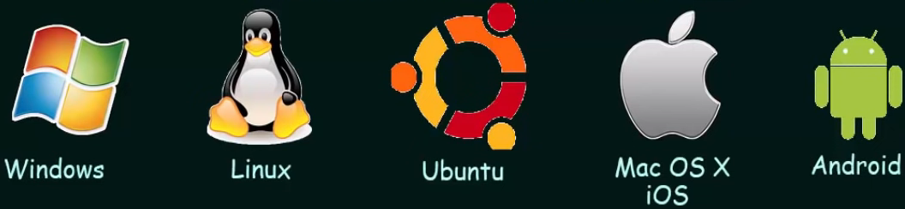
What is an Operating System?
An Operating System (OS) is a program that manages the computer hardware
It also provides a basis for Application Programs
A program that acts as an intermediary between computer user and computer hardware
Notes:
Manager: manage a computer’s hardware
Purpose: to provide an environment in which a user can execute programs in a convenient and efficient manner

Slide 9
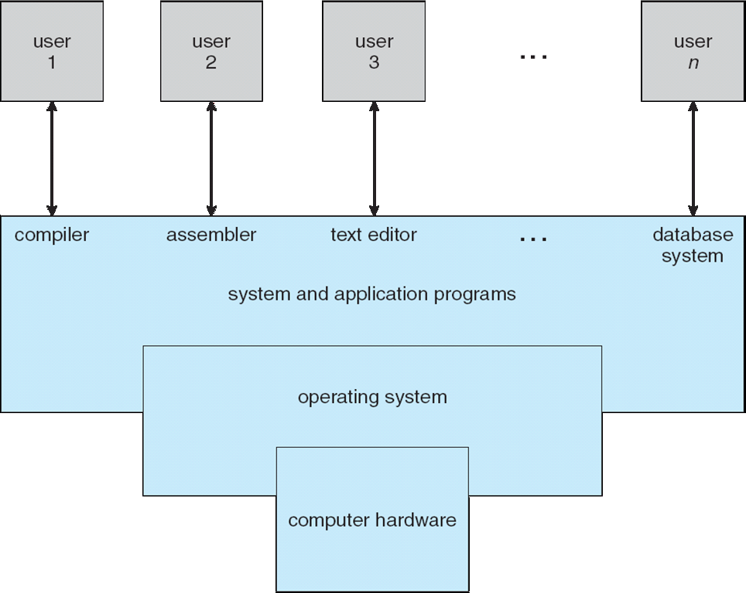

Four Components of a Computer System
If no OS, you must manually tell the computer hardware!
Has to tell the hardware that he wants to do something!
Resources like CPU, Memory, I/O devices
Notes:
System programs are the programs that are used to directly command or modify computer hardware.
Application programs are the programs that are used to perform a specific task and that can be directly used by users.
Just double clicked on the Microsoft word, and then the rest of the things, the operating system takes care of it!
All the underlying things that has to happen, and the communication that has to happen between the hardware the user is taken care by the OS

Slide 10



What is an Operating System?
Operating system goals:
Execute user programs and make solving user problems easier
Make the computer system convenient to use
Use the computer hardware in an efficient manner
Convenience
Efficiency
Security

Slide 11
What Operating Systems Do — User view
One PC user want convenience, ease of use and good performance
Don’t care about resource utilization
But shared computer such as mainframe or minicomputer must keep all users happy
Handheld computers are resource poor, optimized for usability and battery life
Some computers have little or no user interface, such as embedded computers in devices and automobiles
Notes:
Most computer users sit in front of a PC, such system is designed for one user to monopolize its resources; The goal is to maximize the work that the user is performing. In this case, the OS is designed mostly for ease of use
Resource utilization------how various hardware and software resources are shared
Mainframe: these users share resources and may exchange information------OS is designed to maximize resource utilization
Maximize resource utilization: assure that all available CPU time, memory, and I/O are used efficiently, and that no individual user takes more than her fair share
Compromise between individual usability and resource utilization

Slide 12
What Operating Systems Do — System view
OS is a resource allocator
Manages all resources
Example of resources?
Decides between conflicting requests for efficient and fair resource use
Examples of conflicting requests?
OS is a control program
Controls execution of programs to prevent errors and improper use of the computer, especially for I/O
Examples of improper use of computer?
Notes:
All resources: CPU time, memory space, file-storage space, I/O devices, and so on
Facing numerous and possibly conflicting requests for resources, the OS must decide how to allocate them to specific programs and users so that it can operate the computer system efficiently and fairly

Slide 13
Computer Startup
Where is the OS stored on the computer?
What operation or program starts the OS?
bootstrap program is loaded at power-up or reboot
Loads operating system kernel and starts execution
Locate the operating-system kernel and load it into memory
Some services are provided outside of the kernel, by system software
Typically stored in ROM, generally known as firmware
Notes:
The bootstrap program must know how to load the OS and how to start executing that system
Once the kernel is loaded and executing, it can start providing services to the system and its users

Slide 14
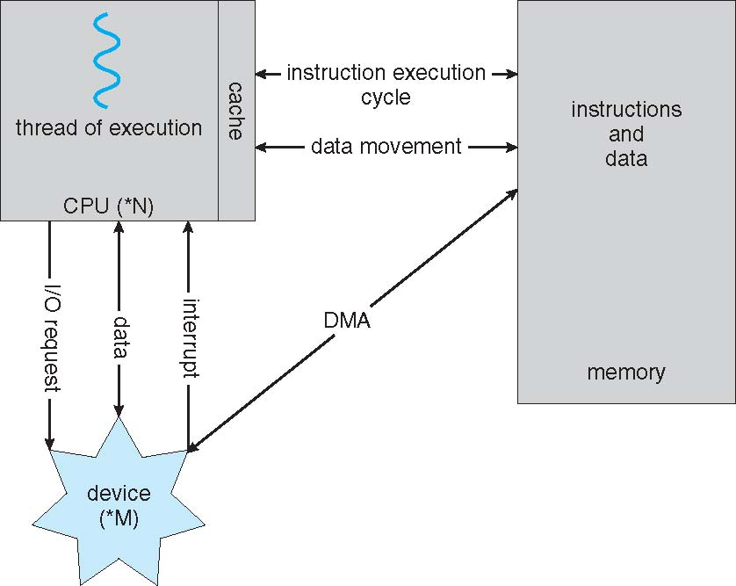
How a Modern Computer Works
instruction-execution cycle
Fetch-Decode–Execute mode
Notes:
The CPU executes a program in a Fetch-Decode –Execute mode by bringing instructions from Memory. So your program has to get loaded into memory, from the Disk.
Generally, both programs and executable files are stored in the Disk. This is where the I/O comes into the picture.
First fetches an instruction from memory and stores that instruction in the instruction register
The instruction is then decoded and may cause operands to be fetched from memory and stored in some internal register
After the instruction on the operands has been executed, the results may be stored back in memory

Slide 15
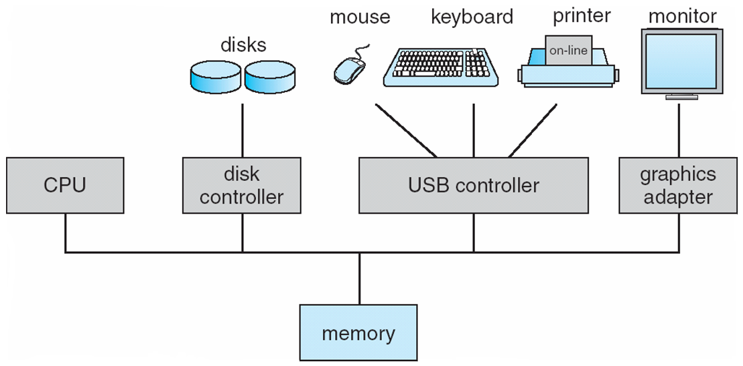
Computer System Organization
I/O devices
Buffer
System bus
An I/O operation is initiated by CPU and the I/O controllers take care of transferring and completing the I/O operation.
The devices operate at wide-ranging data transfer speed and also many different interface standards.
It is overloading on the part of CPU to deal with these devices directly. I/O controllers play a bridging role between CPU, Memory and I/O Device by taking care of all kinds of communication.
Due to heterogeneity of the devices, each device /type of interface requires an I/O Controller
Notes:
Each device controller has a local buffer
CPU moves data from/to main memory to/from local buffers
I/O is from the device to local buffer of controller.
An analogy to this is a classroom environment, wherein a teacher (CPU) assigns work; the student (I/O) submits the solution in a Notebook or uploads at the prescribed place(Memory). Probably the student informs the teacher that it is done or it is not done for some reason(Interrupt).

Slide 16
Computer System Organization
One or more CPUs, device controllers connect through common bus providing access to shared memory
Each device controller is in charge of a particular device type
The CPU and the device controllers can execute concurrently, competing for memory cycles
To ensure orderly access to the shared memory, a memory controller is provided whose function is to synchronize access to the memory
Buffer

Slide 17
Storage Structure
Main memory – only large storage media that the CPU can access directly
Also called Random access memory (RAM)
Rewritable
Computers use other forms of memory as well
Read-only memory (ROM)
Interaction is achieved through a sequence of load or store instructions to specific memory addresses
Notes:
The CPU can load instructions only from memory, so any programs to run must be stored there
Because ROM cannot be changed, only static programs, such as the bootstrap program described earlier, are stored there
EPROM can be changed but cannot be changed frequently and so contains mostly static programs. For example, smartphones have EPROM to store their factory-installed programs
Load: moves from main memory to an internal register within the CPU;
Store: moves the contents of a register to main memory
The CPU automatically loads instructions from main memory for execution

Slide 18
Storage Structure (Cont.)
Ideally, we want the programs and data to reside in main memory permanently. Usually, it is not possible
Too small
Volatile
Secondary storage – extension of main memory that provides large nonvolatile storage capacity
Hard disks – the most common secondary-storage device
Solid-state disks – faster than hard disks, nonvolatile
Stores data in a large DRAM, a hidden hard disk, a battery
Becoming more popular: flash memory
Caching – copying information into faster storage system; main memory can be viewed as a cache for secondary storage
Notes:
Main memory is usually too small to store all needed programs and data permanently
Main memory is a volatile storage device that loses its content when power is turned off or otherwise lost
Most programs (system and application) are stored on a disk until they are loaded into memory
Solid-state disks------stores data in a large DRAM array during normal operation but also contains a hidden hard disk and a battery for backup power
If external power is interrupted, copy data from DRAM to disk; When external power is restored, the controller copies the data back into DRAM
Another form of solid-state disk is flash memory, which is popular in cameras and personal digital assistants (PDAs), in robots

Slide 19
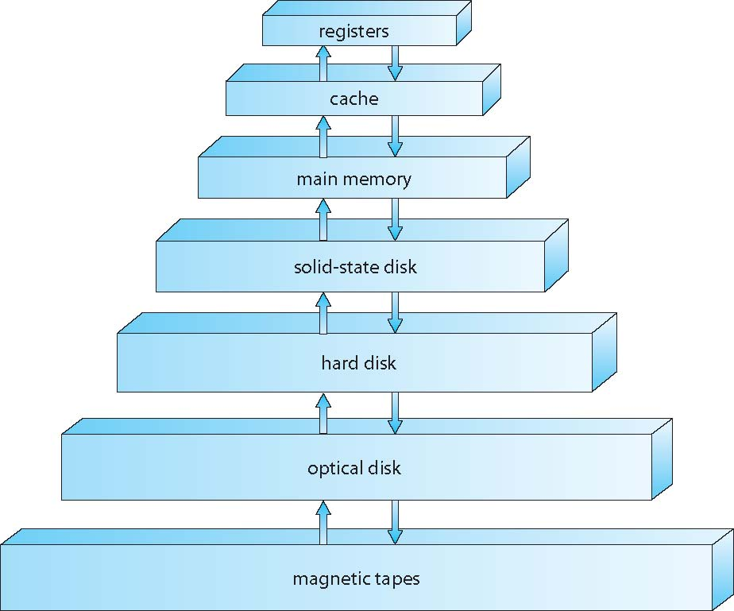
Storage Hierarchy
Storage systems organized in hierarchy
Speed
Cost
Size
Volatility
Notes:
The main differences among the various storage systems lie in speed, cost, size, and volatility
The design of a computer memory system mush balance all the factors just discussed
The wide variety of storage systems can be organized in a hierarchy according to speed and cost
The higher levels are expensive, but they are fast;
As we move down the hierarchy, the cost per bit generally decreases, whereas the access time generally increases
Tradeoff
In addition to differing in speed and cost, the various storage systems are either volatile or non-volatile
As mentioned earlier, volatile storage loses its contents when the power to the device is removed. In the absence of expensive battery, data must be written to non-volatile storage for safe-keeping
In the hierarchy, the storage systems above the solid-state disk are volatile, whereas those including the solid-state disk and below are non-volatile

Slide 20
I/O Operations
How CPU gets a character from the keyboard?
Programmed I/O
Interrupted I/O
Direct Memory Access (DMA)

Slide 21
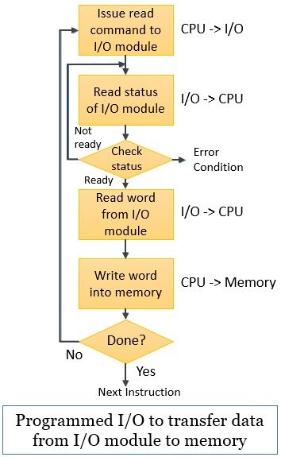
Programmed I/O
How CPU gets a character from the keyboard?
Programmed I/O: a technique that we use to transfer data between the processor and the I/O module.
Regulated with the help of a program.
What’s the greatest drawback of programmed I/O?
a processor keeps on checking whether the I/O module is ready for reception and transmission of data or whether the I/O module has completed the desired task or not. This long waiting of the processor deteriorates the performance of the system.
Notes:
Consider the situation that the processor is busy executing any program. Meanwhile, it encounters an I/O instruction. To execute the encountered instruction the processor issues an appropriate I/O command to the corresponding I/O module
Accepting the issued command, the I/O module performs the desired task and sets some appropriate bits of its I/O status registers
Further, the I/O module does not notify the processor that it has performed the desired task. Moreover, it’s the processors’ responsibility to periodically check the status of the I/O module till it finds that the I/O has successfully completed the desired task.

Slide 22
Programmed I/O
Programmed I/O:
The I/O module does not notify the processor that it has performed the desired task. Moreover, it’s the processors’ responsibility to periodically check the status of the I/O module till it finds that the I/O has successfully completed the desired task.

Slide 23
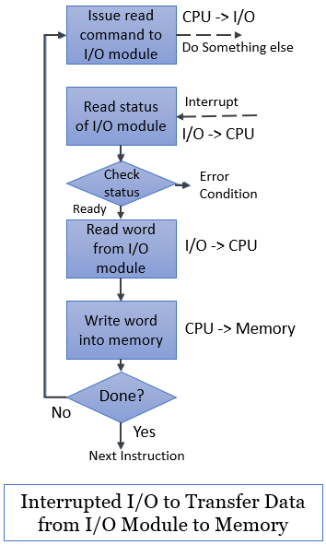
Interrupted I/O
Interrupted I/O: an approach to transfer data between ‘memory’ and ‘I/O devices’ through the ‘processor’
Involves the use of interrupt to exchange data between I/O and memory.
Main idea: after issuing the I/O command to the I/O module the processor can get itself busy doing some other work
Issues an interrupt signal to the processor when I/O has been performed
Notes:
The processor issues a READ I/O command to the corresponding I/O module and proceeds with some other useful tasks. It does not wait for the I/O module to get ready with the desired data.
The I/O module then processes this READ I/O command and reads the data from the addressed peripheral device. The I/O module stores the read data into its data register and issues an interrupt signal to the processor over the control line in the system bus. By sending the interrupted signal, the I/O module indicates the processor that now it is ready for transmitting the data. But, the I/O module has to wait until the processor asks for the data from the I/O module.
As we know that whenever the processor is executing any program, after every instruction cycle it checks for interrupts that have occurred. If it finds the pending interrupts, it responds and serves the occurred interrupt.
The moment processor finds the interrupts by the I/O module, it suspends its current execution and saves the context (e.g., program counter, processor register) to serve the interrupt.
When the processor requests the data from the I/O, it places the data over the data line of the system bus. Once the I/O module transfers the data to the processor it set itself ready for another I/O transfer.
Now processor request data from the I/O module and accept the word of data over the data line. The processor stores this data onto the memory and restores the context of the program it was working on and resumes its execution.

Slide 24
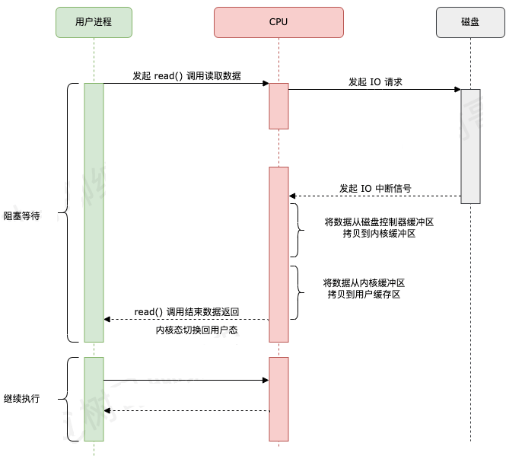
Interrupted I/O
用户进程向 CPU 发起 read 系统调用读取数据，由用户态切换为内核态，然后一直阻塞等待数据的返回。
CPU 在接收到指令以后对磁盘发起 I/O 请求，将磁盘数据先放入磁盘控制器缓冲区。
数据准备完成以后，磁盘向 CPU 发起 I/O 中断。
CPU 收到 I/O 中断以后将磁盘缓冲区中的数据拷贝到内核缓冲区，然后再从内核缓冲区拷贝到用户缓冲区。
用户进程由内核态切换回用户态，解除阻塞状态，然后等待 CPU 的下一个执行时间钟。

Slide 25
Programmed I/O V.S. Interrupted I/O
Programmed I/O：程序直接控制方式就是CPU告诉外设“我要读了”，然后外设开始准备。CPU这时候停下手中的工作，不停的问外设“好了没有”，一旦外设说“好了”，CPU就从外设读一个字，再往内存写一个字，然后再告诉外设“我要继续读”，就这么重复直到完成。所以在读的过程中CPU别的什么也干不了。
Interrupted I/O：CPU告诉外设“我要读了”，然后就不管了，继续干自己的事。这时候外设开始准备，等准备好了就主动告诉CPU“我好了”，CPU这时候停下手里的工作开始从外设读一个字，然后往内存写一个字。写完了就告诉外设“我要继续读”，说完了就继续干刚才被打断前的事，等外设再准备好以后再通知CPU，直到完成。中断方式的好处就是CPU在外设准备的时候不用不停地问，可以做自己的事，提高了利用率。

Slide 26
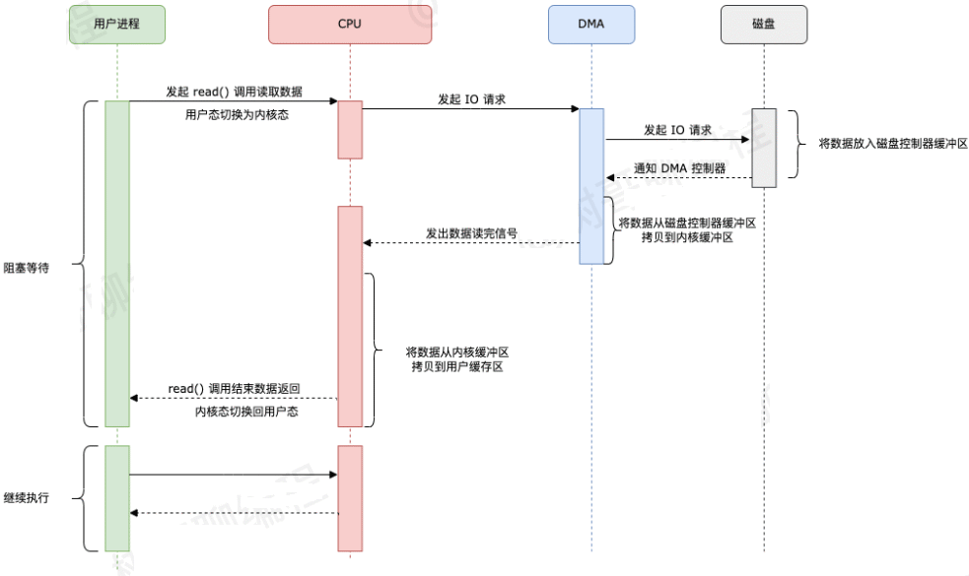
Direct Memory Access (DMA)
Direct Memory Access (DMA) : transfers the data between memory and peripheral devices(like hard drives) without the intervention of the CPU.
DMA 技术优化了数据从磁盘缓冲区拷贝到内核缓冲区这个过程，减少了这个过程里 CPU 的参与。
Notes:
用户进程向 CPU 发起 read 系统调用读取数据，由用户态切换为内核态，然后一直阻塞等待数据的返回。
CPU 在接收到指令以后对 DMA 磁盘控制器发起调度指令。
DMA 磁盘控制器对磁盘发起 I/O 请求，将磁盘数据先放入磁盘控制器缓冲区，CPU 全程不参与此过程。
数据读取完成后，DMA 磁盘控制器会接受到磁盘的通知，将数据从磁盘控制器缓冲区拷贝到内核缓冲区。
DMA 磁盘控制器向 CPU 发出数据读完的信号，由 CPU 负责将数据从内核缓冲区拷贝到用户缓冲区。
用户进程由内核态切换回用户态，解除阻塞状态，然后等待 CPU 的下一个执行时间钟。
仔细对比加入 DMA 技术之后的数据传输流程，我们可以发现 DMA 技术优化了数据从磁盘缓冲区拷贝到内核缓冲区这个过程，减少了这个过程里 CPU 的参与。

Slide 27
Direct Memory Access (DMA)
DMA方式：CPU告诉外设“你把XXX个字的内容写到内存的XXX位置去吧”，然后就不管了，等外设准备好了就通知CPU“我准备好了”，然后CPU让出一个节拍的总线使用权，外设就可以直接把数据送入内存，然后再通知CPU说“我传完了”，然后CPU进行一些清理工作就可以了。DMA比中断方式又有提高，因为中断方式中，数据从外设输入内存依然要CPU参与，而DMA在大量数据读入的时候不需要CPU参与，这就节约了CPU的时间。
通道就是相当于有一个处理器专门来管数据传送，只要CPU把指令告诉通道，通道就可以完成一切数据传输任务，所以CPU的利用率更高。

Slide 28
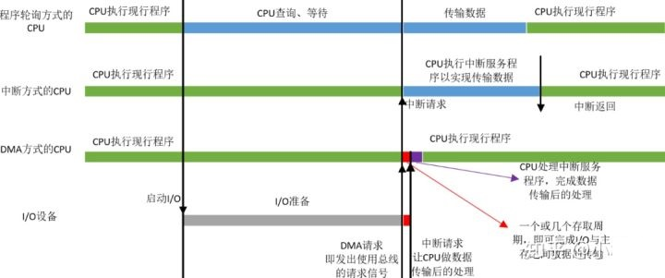
Direct Memory Access (DMA)
当I/O准备就绪，设备向CPU发出DMA请求，CPU响应请求，关闭对主存的控制器，只关闭一个或者几个存取周期，在这一小段时间内，主存和设备完成数据交换。
而且在这一小段时间内，CPU并不是什么都不能做，虽然CPU不能访问主存，即不能取指令，但是CPU的cache中已经保存了一些指令，CPU可以先执行这些指令，只要这些指令不涉及访存，CPU和设备还是并行执行。
数据传输完成后，DMA接口向CPU发出中断请求，让CPU做后续处理。

Slide 29
Quiz
系统将数据从磁盘读到内存的过程包括以下操作：
① DMA控制器发出中断请求
② 初始化DMA控制器并启动磁盘
③ 从磁盘传输一块数据到内存缓冲区
④ 执行“DMA结束”中断服务程序
正确的执行顺序是（ ）。
A. ③→①→②→④
B. ②→③→①→④
C. ②→①→③→④
D. ①→②→④→③
2017年全国统考真题，第32题

Slide 30
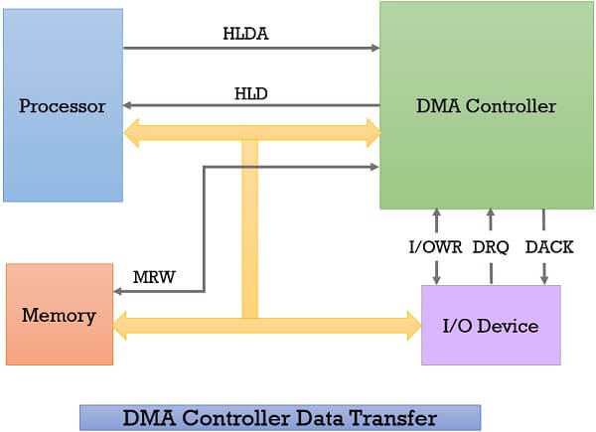
Direct Memory Access (DMA)
Notes:
Whenever an I/O device wants to transfer the data to or from memory, it sends the DMA request (DRQ) to the DMA controller. DMA controller accepts this DRQ and asks the CPU to hold for a few clock cycles by sending it the Hold request (HLD).
CPU receives the Hold request (HLD) from DMA controller and relinquishes the bus and sends the Hold acknowledgement (HLDA) to DMA controller.
After receiving the Hold acknowledgement (HLDA), DMA controller acknowledges I/O device (DACK) that the data transfer can be performed, and DMA controller takes the charge of the system bus and transfers the data to or from memory.
When the data transfer is accomplished, the DMA raise an interrupt to let know the processor that the task of data transfer is finished and the processor can take control over the bus again and start processing where it has left.

Slide 31
Direct Memory Access (DMA)
Device controller transfers blocks of data from buffer storage directly to main memory without CPU intervention
Only one interrupt is generated per block, rather than the one interrupt per byte
Used for high-speed I/O devices able to transmit information at close to memory speeds

Slide 32
Direct Memory Access (DMA)
The DMA controller transfers the data in three modes:
Burst Mode: Here, once the DMA controller gains the charge of the system bus, then it releases the system bus only after completion of data transfer. Till then the CPU has to wait for the system buses.
Cycle Stealing Mode: In this mode, the DMA controller forces the CPU to stop its operation and relinquish the control over the bus for a short term to DMA controller. After the transfer of every byte, the DMA controller releases the bus and then again requests for the system bus. In this way, the DMA controller steals the clock cycle for transferring every byte.
Transparent Mode: Here, the DMA controller takes the charge of system bus only if the processor does not require the system bus.

Slide 33
Direct Memory Access (DMA)
Direct Memory Access Advantages and Disadvantages
Advantages:
Transferring the data without the involvement of the processor will speed up the read-write task.
DMA reduces the clock cycle requires to read or write a block of data.
Implementing DMA also reduces the overhead of the processor.
Disadvantages
As it is a hardware unit, it would cost to implement a DMA controller in the system.

Slide 34
Quiz
若设备采用周期挪用DMA方式进行输入和输出，每次 DMA 传送的数据块大小为512 字节，相应的I/O 接口中有一个32位数数据缓冲寄存器。对于数据输入过程，下列叙述中，错误的是
A.每准备好 32位数据，DMA控制器就发出一次总线请求
B.相对于CPU，DMA控制器的总线使用权的优先级更高
C.在整个数据块的传送过程中，CPU不可以访问主存储器
D.数据块传送结束时，会产生"DMA 传送结束"中断请求
2020年全国统考真题，第22题

Slide 35
Quiz
下列关于中断I/O方式和DMA方式比较的叙述中，错误的是（）
中断I/O方式请求的是CPU处理时间，DMA方式请求的是总线使用权
中断响应发生在一条指令执行结束后，DMA响应发生在一个总线事务完成后
中断I/O方式下数据传送通过软件完成，DMA方式下数据传送由硬件完成
中断I/O方式适用于所有外部设备，DMA方式仅适用于快速外部设备
2013全国统考真题，第22题

Slide 36
Operating System Structure
Multiprogramming is needed for efficiency
Single user cannot keep CPU and I/O devices busy at all times
Multiprogramming organizes jobs (code and data) so CPU always has one to execute
Basic idea of multiprogramming
A subset of total jobs in system is kept in memory
One job selected and run via job scheduling
When it has to wait (for I/O for example), OS switches to another job
Notes:
An operating system provides the environment within which programs are executed
One of the most important aspects of operating system is the ability to multi-program;
Multiprogramming increases CPU utilization by organizing jobs (code and data) so that the CPU always has one to execute
Since, in general, main memory is too small to accommodate all jobs, the jobs are kept initially on the disk in the job pool
This pool consists of all processes residing on disk awaiting allocation of main memory
Eventually, the job may have to wait for some task, such as an I/O operation, to complete; In a non-multiprogrammed system, the CPU would sit idle; In a multiprogrammed system, the OS simply switches to and execute another job; When that job needs to wait, the CPU switches another job, and so on; Eventually, the first job finishes waiting and gets CPU back; As long as at least one job needs to execute, the CUP is never idle

Slide 37
Operating System Structure (Cont.)
Timesharing (multitasking) is logical extension in which CPU switches jobs so frequently that users can interact with each job while it is running, creating interactive computing
Response time should be < 1 second
Each user has at least one program executing in memory process
Timesharing and multiprogramming require that several jobs be kept simultaneously in memory
If several jobs ready to be brought into memory  Job scheduling
If several jobs ready to run at the same time  CPU scheduling
In timesharing, the OS must ensure reasonable response time
If processes don’t fit in memory, swapping moves them in and out to run
Virtual memory allows execution of processes not completely in memory
Notes:
Multiprogrammed systems provide an environment in which the various system resources (for example, CPU, memory, and peripheral devices) are utilized effectively, but they do not provide for user interaction with the computer system.
Timesharing provides direct communication between the user and the system: the user gives instructions to the OS or to a program directly using a input device, and waits for immediate results on an output device
As the system switches rapidly from one user to the next, each user is given the impression that the entire computer system is dedicated to his use, even though it is being shared among many users
%%%%%%%%%%%%%%%%%%%%%%%%%%%
If several jobs are ready to be brought into memory, and if there is not enough room for all of them, then the system must choose among them; Making this decision involves job scheduling
%%%%%%%%%%%%%%%%%%%%%%%%%%%
Swapping /swɒp/ is a useful technique that enables a computer to execute programs and manipulate data files larger than main memory. The operating system copies as much data as possible into main memory, and leaves the rest on the disk. When the operating system needs data from the disk, it exchanges a portion of data (called a page or segment) in main memory with a portion of data on the disk.
Virtual memory: it enables users to run programs that are larger than actual physical memory; It abstracts main memory into a large, uniform array of storage, separating logical memory as viewed by the user from physical memory.
This arrangement frees programmers from concern over memory-storage limitations.

Slide 38
Quiz
下列关于多任务操作系统的叙述，正确的是
I. 具有并发和并行的特点
II. 需要实现对共享资源的保护
III. 需要运行在多 CPU 的硬件平台上
仅 I
仅 II
仅 I、II
I、II、II
2018全国统考真题，第23题

Slide 39
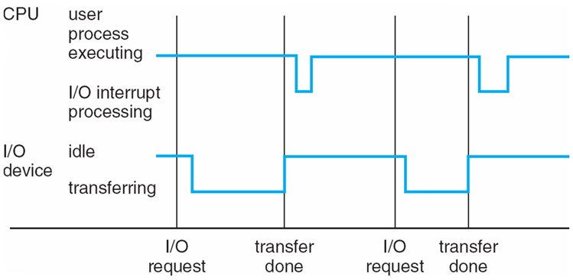
Interrupts
Interrupt driven (hardware and software)
Hardware interrupt by one of the devices
I/O operation is completed
Software interrupt (exception or trap):
Software error (e.g., division by zero)
Invalid memory access
A specific request from user program that an OS service be performed
Events are almost always signaled by the occurrence of an interrupt or a trap
Notes:
A trap is a software-generated interrupt caused either by an error (for example, division by zero or invalid memory access); or by a specific request from user program that an OS service be performed
For example, if a process gets stuck in an infinite loop, this loop could prevent the correct operation of many other processes
More subtle errors can occur in a multiprogramming system, where one erroneous program might modify another program, the data of another program, or even the operating system itself

Slide 40
Quiz
异常是指令执行过程中在处理器内部发生的特殊事件，中断是来自处理器外部的请求事件。下列关于中断或异常情况的叙述中，错误的是
A."访存时缺页"属于中断
B."整数除以0"属于异常
C."DMA传送结束"属干中断
D."存储保护错"属于异常

Slide 41
Interrupts (Cont.)
Given a specific interrupt, what action should be taken?
Separate segments of code in the operating system determines what action should be taken
An interrupt service routine is provided to deal with the interrupt
Interrupt occur
CPU stops what it is doing
Transfer execution
On completion, CPU resumes
How to find the corresponding interrupt service routine

Slide 42
Interrupts (Cont.)
Interrupt transfers control to the interrupt service routine generally, through the interrupt vector, which contains the addresses of all the service routines
A table of pointers to interrupt routines

Slide 43
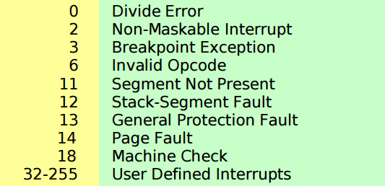
Interrupts (Cont.)
Every interrupt type is assigned a number:
Interrupt vector
A table of pointers to interrupt routine
When an interrupt occurs, the vector determines what code is invoked to handle the interrupt
Example: vector 14 page fault handler

Slide 44
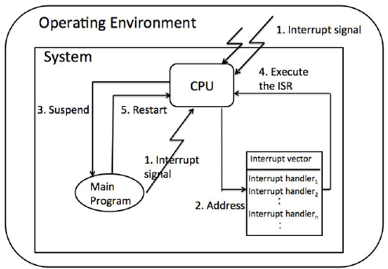
Interrupts (Cont.)
The interrupt must transfer control to the appropriate interrupt service routine
Thus, the interrupt routine is called indirectly through the table

Slide 45
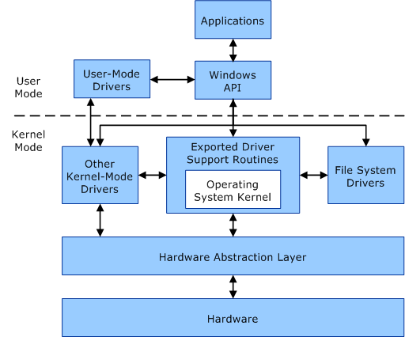
Operating-System Operations (cont.)
A processor in a computer running Windows operates in two different modes: user mode and kernel mode.
The processor switches between these modes depending on the type of code it's executing.
Applications operate in user mode, while core operating system components function in kernel mode.

Slide 46
Operating-System Operations (cont.)
User mode
Each application's virtual address space is private, one application can't modify another application's data.
Each application runs in isolation
The virtual address space of a user-mode application is also limited.
Kernel mode
All code running in kernel mode shares a single virtual address space.
If a kernel-mode driver mistakenly writes to the wrong virtual address, it could compromise data belonging to the operating system or another driver.
If a kernel-mode driver crashes, it causes the entire operating system to crash.

Slide 47
Operating-System Operations (cont.)
Proper execution: distinguish between the execution of operating-system code and user-defined code
Dual-mode operation allows OS to protect itself and other system components
User mode and kernel mode
Mode bit provided by hardware
Provides ability to distinguish when system is running user code or kernel code
System call changes mode to kernel, return from call resets it to user
Protection operating system
Some instructions designated as privileged, only executable in kernel mode
Notes:
When the computer system is executing on behalf of a user application, the system is in user mode; However, when a user application requests a service from the operating system (via a system call), the system must transition from user to kernel mode to fulfill the request
%%%%%%%%%%%%%%%%%%%
We accomplish this protection by designating some of the machine instructions that may cause harm as privileged instructions
If an attempt is made to execute a privileged instruction in user mode, the hardware does not execute the instruction but rather treats it as illegal and traps it to the operating system

Slide 48
Operating-System Operations (cont.)
Life cycle of instruction execution
Execute user app
Initial:
kernel mode
user mode
Interrupt
System call
Without hardware-supported dual mode (for example, MS-DOS), a user program can wipe out the operating system by writing over it with data; multiple programs are able to write to a device at the same time

Slide 49

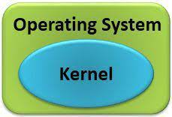
System Call
Request service
e.g.:
open a file
create a process
……
User program
API: open(), fork()
……
System call provides the services of the operating system to the user programs via Application Program Interface (API).
It provides an interface between a process and operating system to allow user-level processes to request services of the operating system.
System calls are the only entry points into the kernel system.

Slide 50
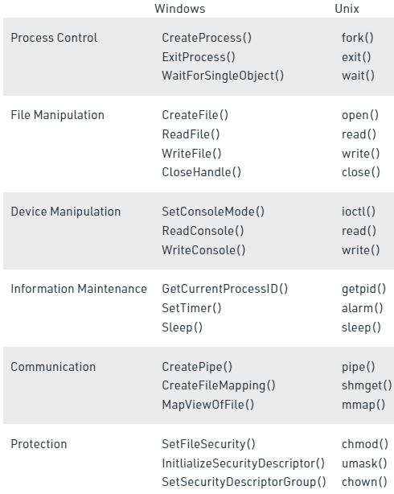
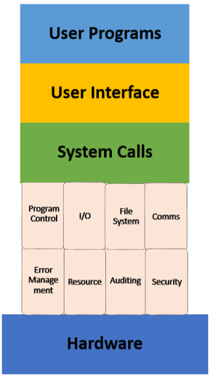
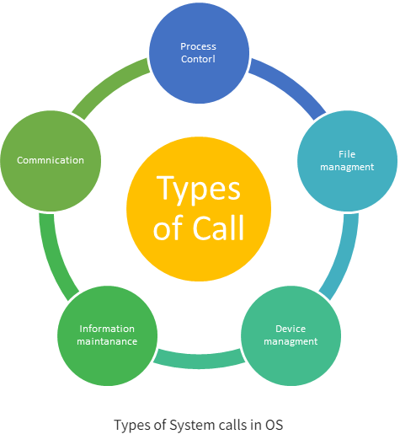
System Call

Slide 51
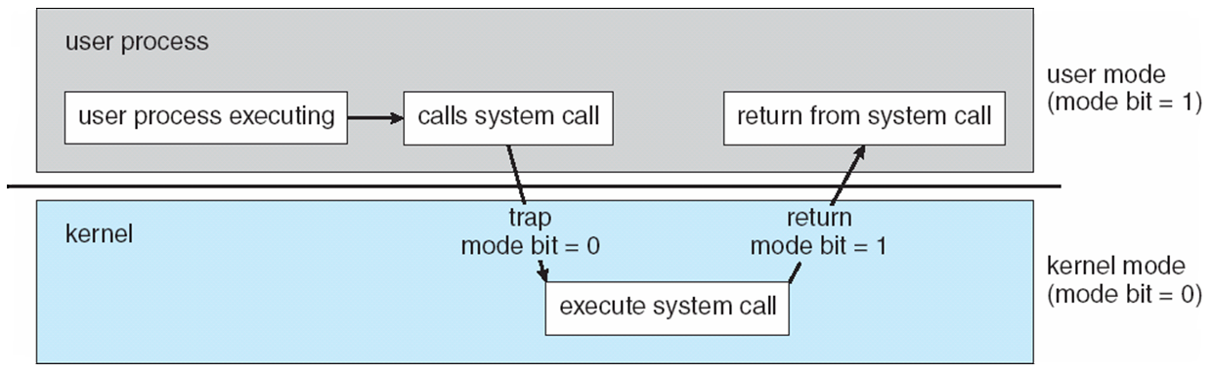
Transition from User to Kernel Mode

Slide 52
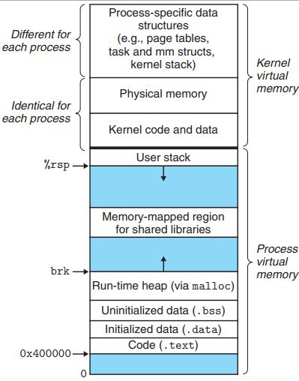
User mode
Because an application's virtual address space is private, one application cannot alter data that belongs to another application
Each application runs in isolation, and if an application crashes, the crash is limited to that one application.
Other applications and the operating system are not affected by the crash.

Slide 53
User mode
In addition to being private, the virtual address space of a user-mode application is limited
A processor running in user mode cannot access virtual addresses that are reserved for the operating system.
Limiting the virtual address space of a user-mode application prevents the application from altering, and possibly damaging, critical operating system data.

Slide 54
Kernel mode
All code that runs in kernel mode shares a single virtual address space.
This means that a kernel-mode driver is not isolated from other drivers and the operating system itself.
If a kernel-mode driver accidentally writes to the wrong virtual address, data that belongs to the operating system or another driver could be compromised.
If a kernel-mode driver crashes, the entire operating system crashes.

Slide 55
Quiz
Which of the following should NOT be allowed in user mode?
Disable all interrupts.
Read the time-of-day clock
Set the time-of-day clock
Perform a trap

Slide 56
Quiz
执行系统调用的过程包括如下主要操作：
①返回用户态
②执行陷入（trap）指令
③传递系统调用参数
④执行相应的服务程序
正确的执行顺序是
A.②—>③—>①—>④
B.②—>④—>③—>①
C.③—>②—>④—>①
D.③—>④—>②—>①
2017年全国统考真题，第24题

Slide 57
Process Management Activities
The operating system is responsible for the following activities in connection with process management:
Scheduling processes and threads on the CPUs
Creating and deleting both user and system processes
Suspending and resuming processes
Providing mechanisms for process synchronization
Providing mechanisms for process communication
Providing mechanisms for deadlock handling

Slide 58
Memory Management
To execute a program all (or part) of the instructions must be in memory
All (or part) of the data that is needed by the program must be in memory.
Memory management determines what is in memory and when
Optimizing CPU utilization and computer response to users
Memory management activities
Keeping track of which parts of memory are currently being used and by whom
Deciding which processes (or parts thereof) and data to move into and out of memory
Allocating and deallocating memory space as needed
Notes:
Main memory is a repository of quickly accessible data shared by the CPU and I/O devices
CPU reads instructions from main memory during the instruction-fetch cycle and both reads and writes data from main memory during the data-fetch cycle
The main memory is generally the only large storage device that the CPU is able to address and access directly
For example, for the CPU to process data from disk, those data must first be transferred to main memory by CPU-generated I/O calls
%%%%%%%%%%%%%%%%
To improve both the utilization of the CPU and the speed of the computer’s response to its users, computer must keep several
%%%%%%%%%%%%%%%
The OS is responsible for the following activities in connection with memory management

Slide 59
Storage Management
OS provides uniform, logical view of information storage
Abstracts physical properties to logical storage unit - file
File
a collection of related information defined by its creator
files represent programs and data
Notes:
To make the computer system convenient for users, the operating system provides a uniform, logical view of information storage
The operating system abstracts from the physical properties of its storage devices to define a logical storage unit, the file
The operating system maps files onto physical media and accesses these files via the storage devices
%%%%%%%%%%%%%%%%%%%%%%
Computers can store information on several different types of physical media, each of these media has its own characteristics and physical organization
A file is a collection of related information defined by its creator; files represent programs and data
When multiple users have access to files, it may be desirable to control which user may access a file and how that user may access it

Slide 60
Mass-Storage Management
Usually disks used to store data that does not fit in main memory or data that must be kept for a “long” period of time
Proper management is of central importance
Entire speed of computer operation hinges on disk subsystem and its algorithms
OS activities
Free-space management
Storage allocation
Disk scheduling
Notes:
As we have already seen, because main memory is too small to accommodate all data and programs, and because the data that is holds are lost when power is lost, the computer system must provide secondary storage to back up main memory
%%%%%%%%%%%%%%%%%%%%%%%%%
Most modern computer systems use the disk as both the source and destination of their processing; Hence the proper management of disk storage is of central importance to a computer system

Slide 61
Performance of Various Levels of Storage
Figure compares performance of various levels of storage
For example, data transfer from cache to CPU and registers is usually a hardware function, with no operating system intervention
In contrast, transfer of data from disk to memory is usually controlled by the operating system

Slide 62
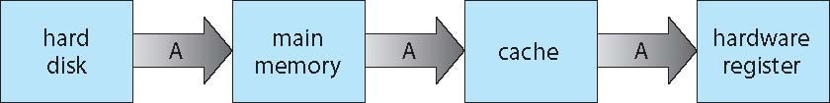
Migration of data “A” from Disk to Register
Multitasking environments must be careful to use most recent value, no matter where it is stored in the storage hierarchy
Multiprocessor environment must provide cache coherency in hardware such that all CPUs have the most recent value in their cache
Distributed environment situation even more complex
Several copies of a datum can exist
Various solutions covered in Chapter 17

Slide 63
Migration of data “A” from Disk to Register
Multitasking environments must be careful to use most recent value, no matter where it is stored in the storage hierarchy
For example, suppose that an integer A that is to be incremented by 1 is located in file B, B resides on disk;
The increment operation proceeds by first issuing an I/O operation to copy the disk block on which A resides to main memory;
This operation is followed by copying A to the cache and to an internal register
Thus, the copy of A appears in several places: on the disk, in main memory, in the cache, and in a integer register
On the increment takes place in the internal register, the value of A differs in the various storage systems; The values of A becomes the same only after the new value of A is written from the internal register back to the disk

Slide 64
Migration of data “A” from Disk to Register
Multitasking environments must be careful to use most recent value, no matter where it is stored in the storage hierarchy
This situation becomes more complicated in a multiprocessor environment where, in addition to maintaining internal registers, each of the CPUs also contains a local cache.
In such an environment, a copy of A many exist simultaneously in several caches.
Since the various CPUs can all execute in parallel, we must make sure that an update to the value of A in one cache is immediately reflected in all other caches where A resides. This situation is called cache coherency
In a distributed environment, several copies of the same file can be kept on different computers

Slide 65
End of Chapter 1

